Slide 1
CS 170 Segment 7 Machine Learning 2
Notes based from Dr. Eamonn Keogh

Slide 2
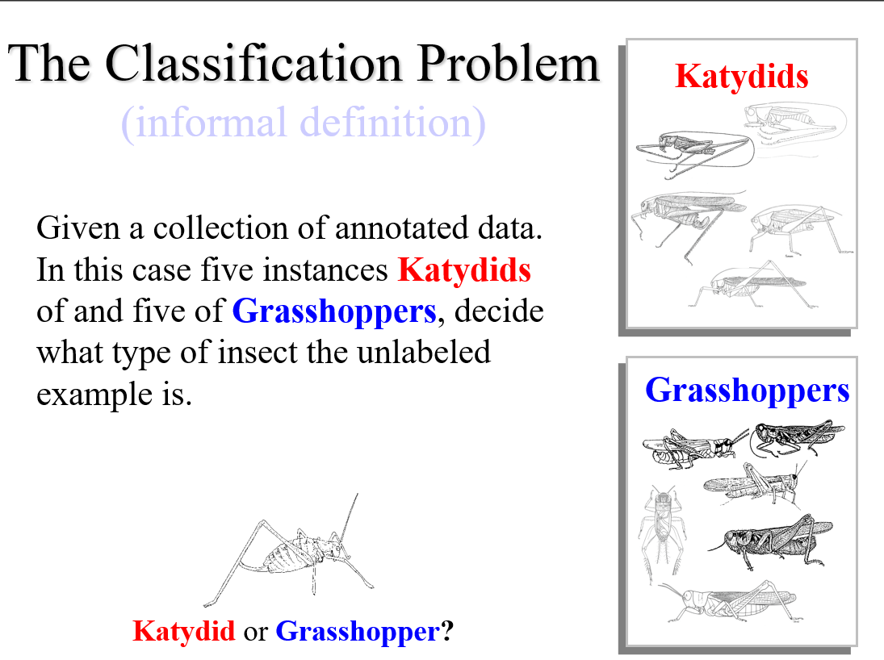

Slide 3
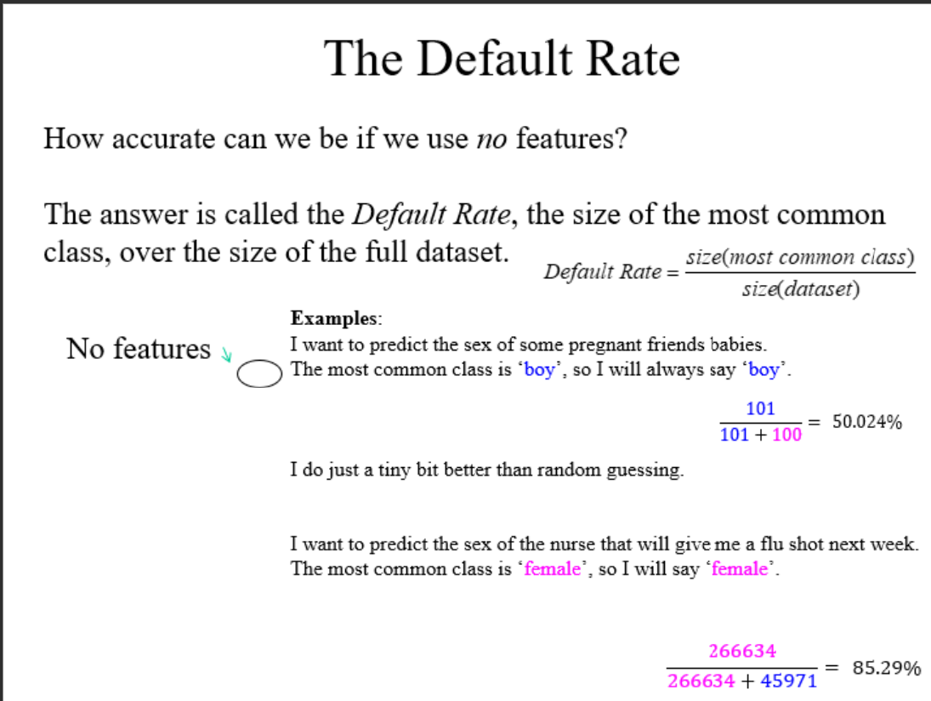

Slide 4
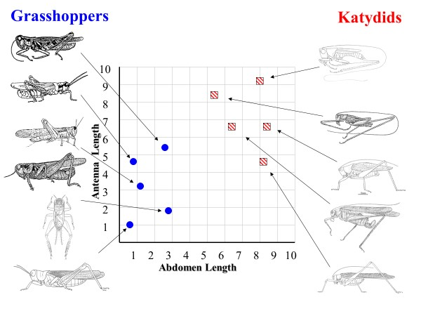
So far, we have assumed that we are given X features, and we just choose the best algorithm to classify them
However, there are two “tricks” that can greatly improve our accuracy
Reduce the number of features to Y informative features, with Y << X
Generate new features, from combinations of old features
Doing these well is a black art, but can make a huge difference

Slide 5
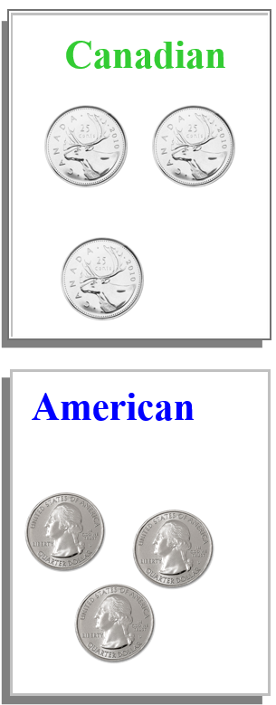
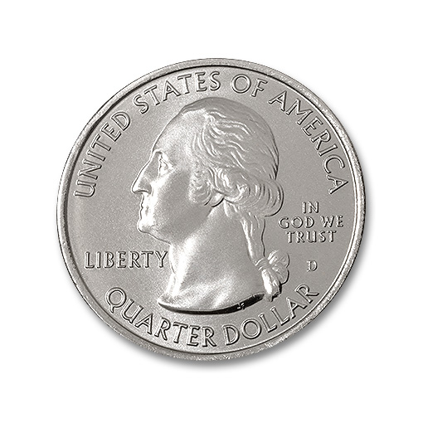
The Classification Problem (informal definition)
Given a collection of annotated data. In this case 3 instances of Canadian and 3 of American, decide what type of coin the unlabeled example is.

Slide 6
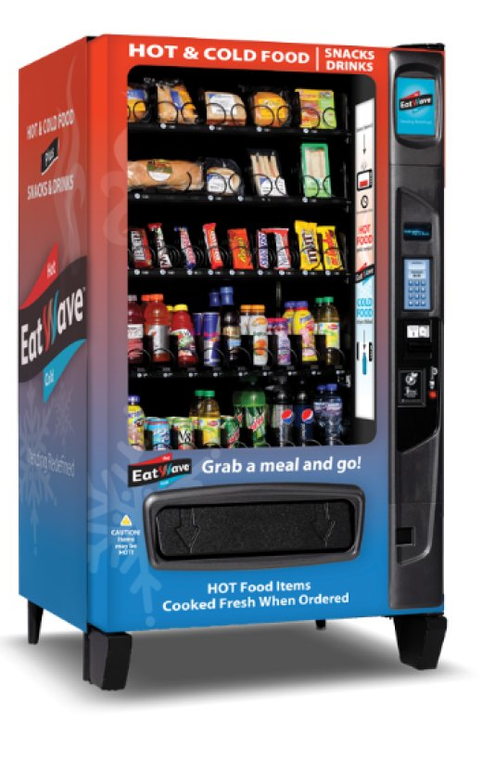
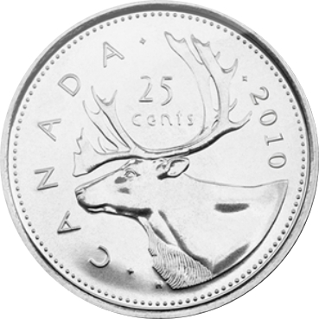
Blame Canada

Slide 7
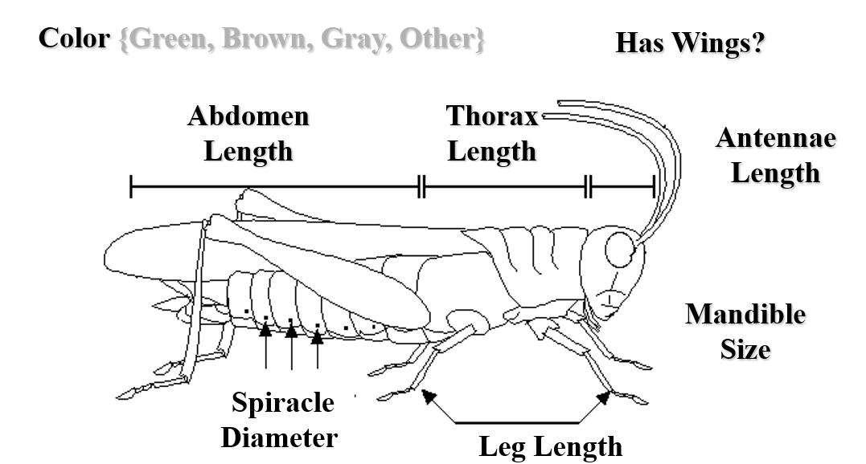
For any domain of interest, we can measure features

Slide 8
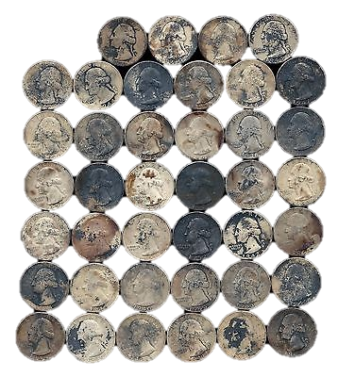
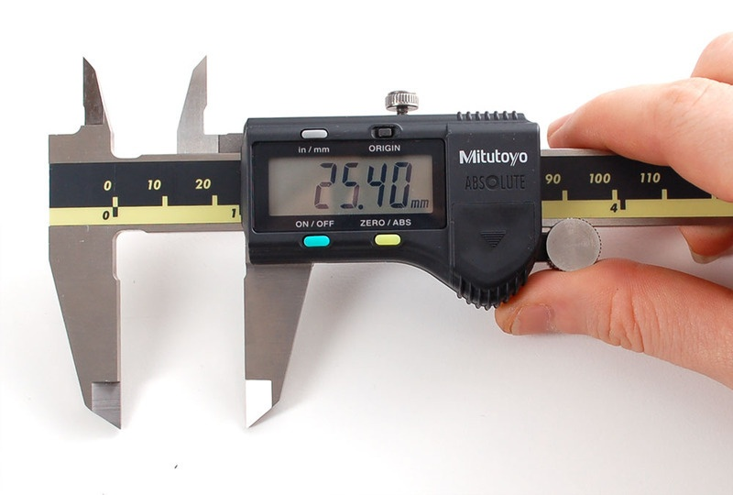
What features can we cheaply measure from coins?
Diameter
Thickness
Weight
Electrical Resistance
?
Probably not color or other optical features.

Slide 9
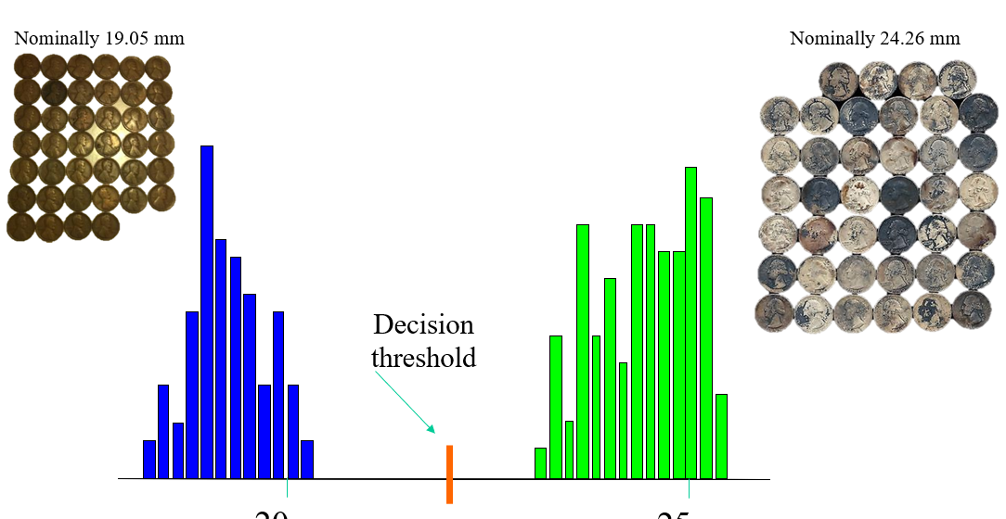
The Ideal Case
In the best case, we would find a single feature that would strongly separate the coins. Diameter is clearly such a feature for the simpler case of pennies vs. quarters.

Slide 10
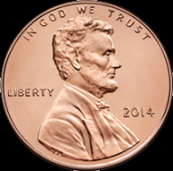
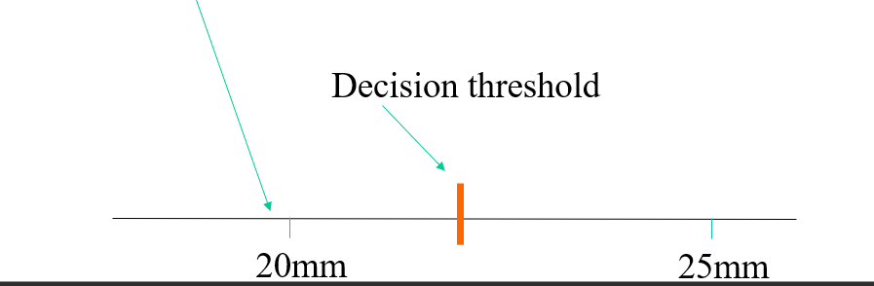
Usage
Once we learn the threshold, we no longer need to keep the data.
When an unknown coin comes in, we measure the feature of interest, and see which side of the decision threshold it lands on.
IF diameter(unknown_coin) < 22
coin_type = ‘penny’
ELSE
coin_type = ‘quarter’
END
?

Slide 11

Let us revisit the original problem of classifying Canadian vs. American Quarters
Which of our features (if any) are useful?
Diameter
Thickness
Weight
Electrical Resistance
I measured these features for 50 Canadian and 50 American quarters….

Slide 12
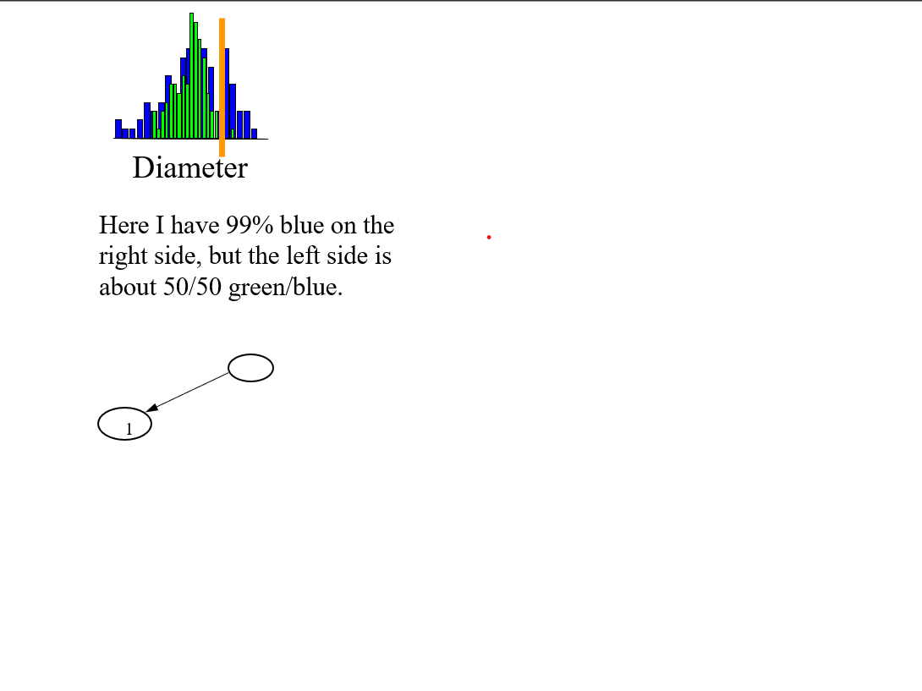

Slide 13
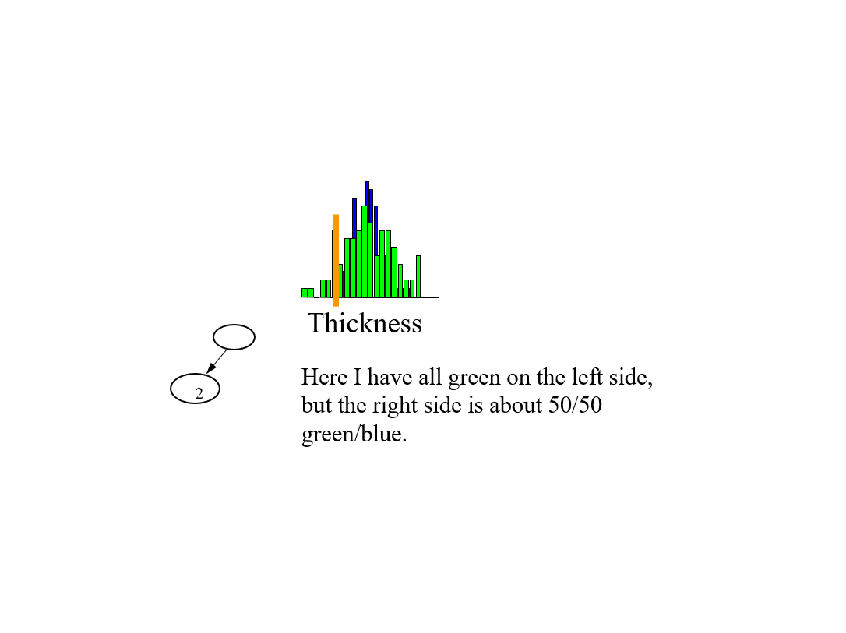

Slide 14
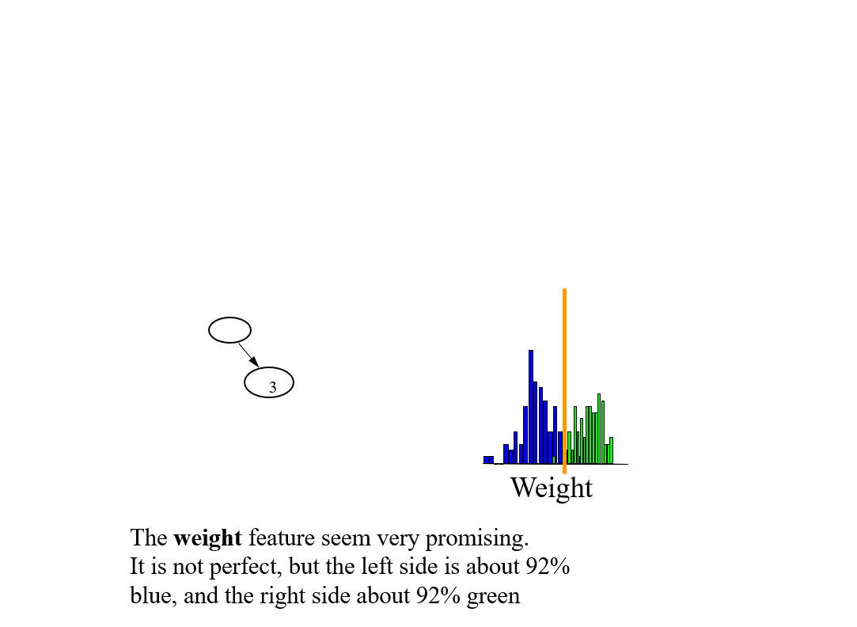

Slide 15
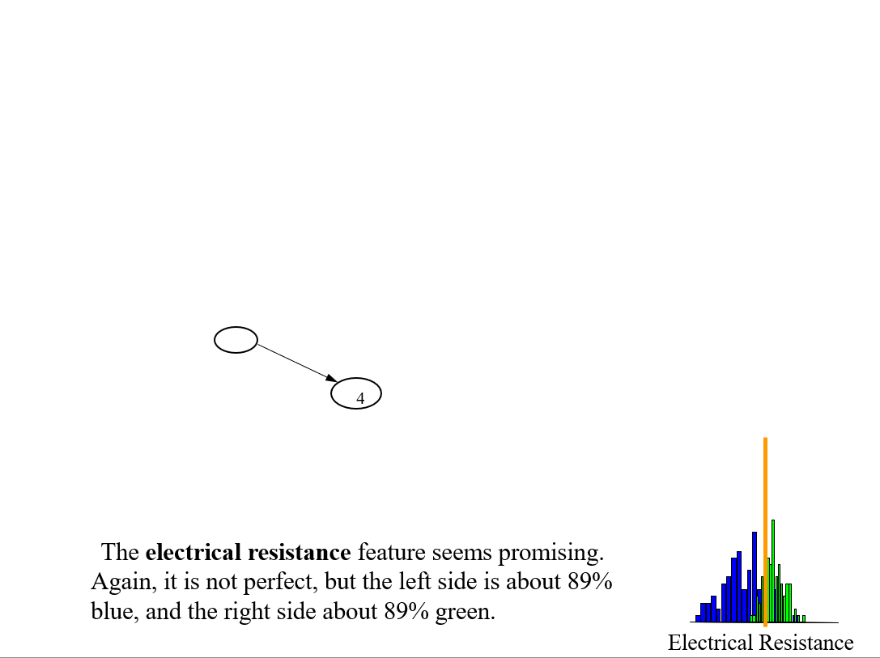

Slide 16
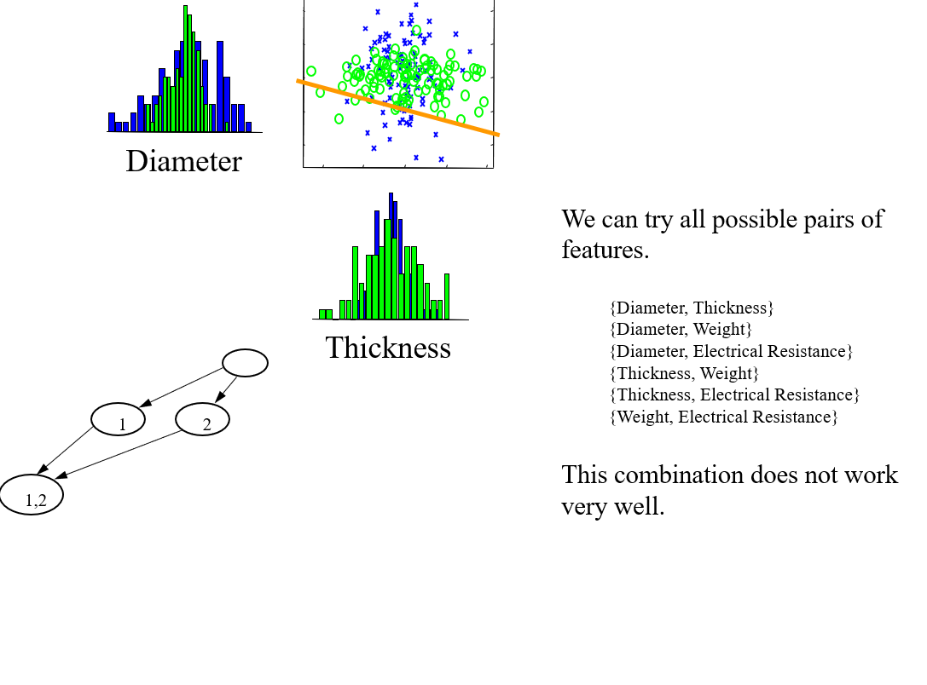

Slide 17
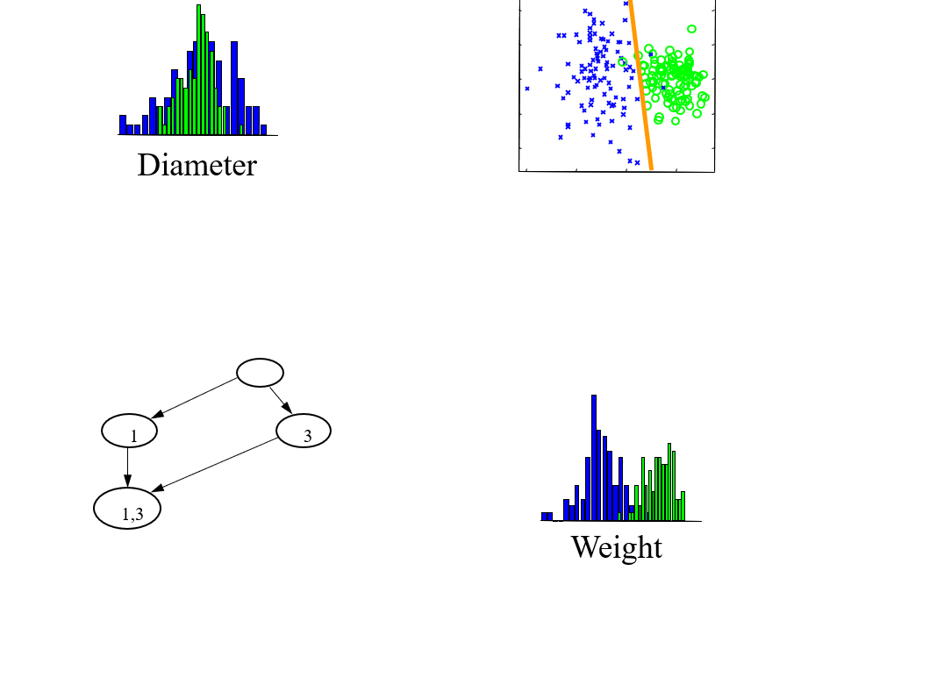

Slide 18
For brevity, some combinations are omitted
Let us jump to the last combination…

Slide 19
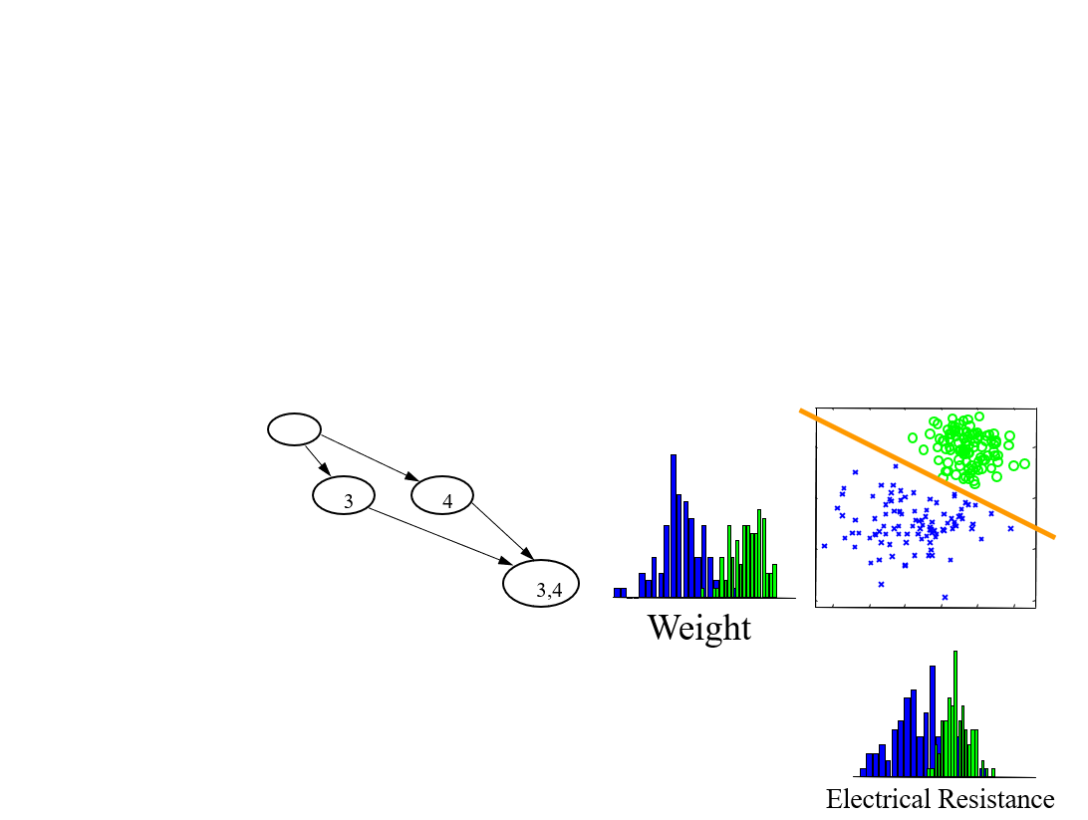

Slide 20
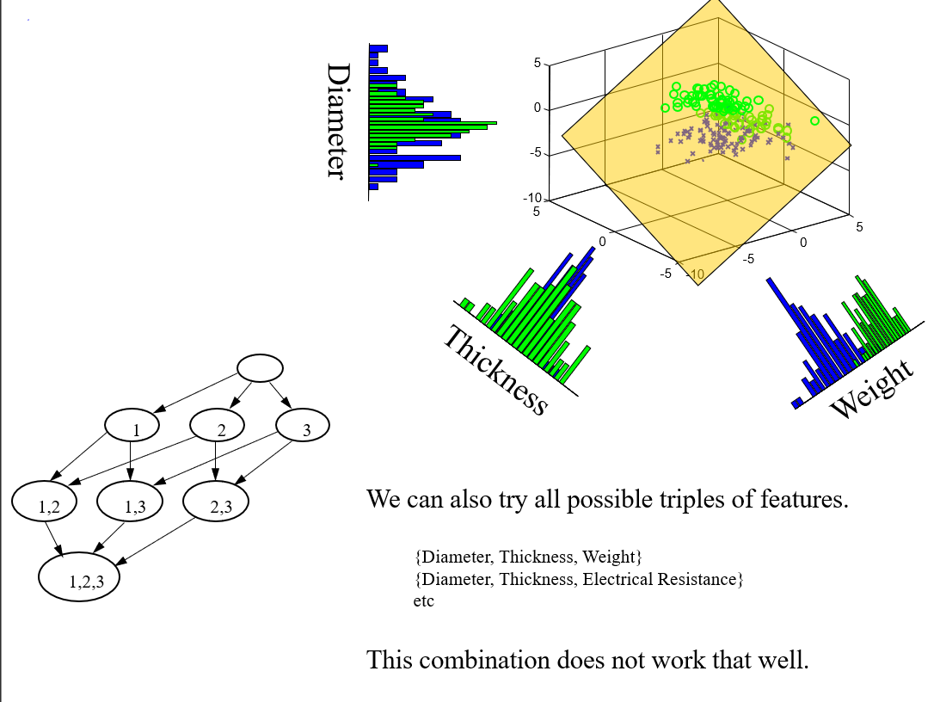

Slide 21
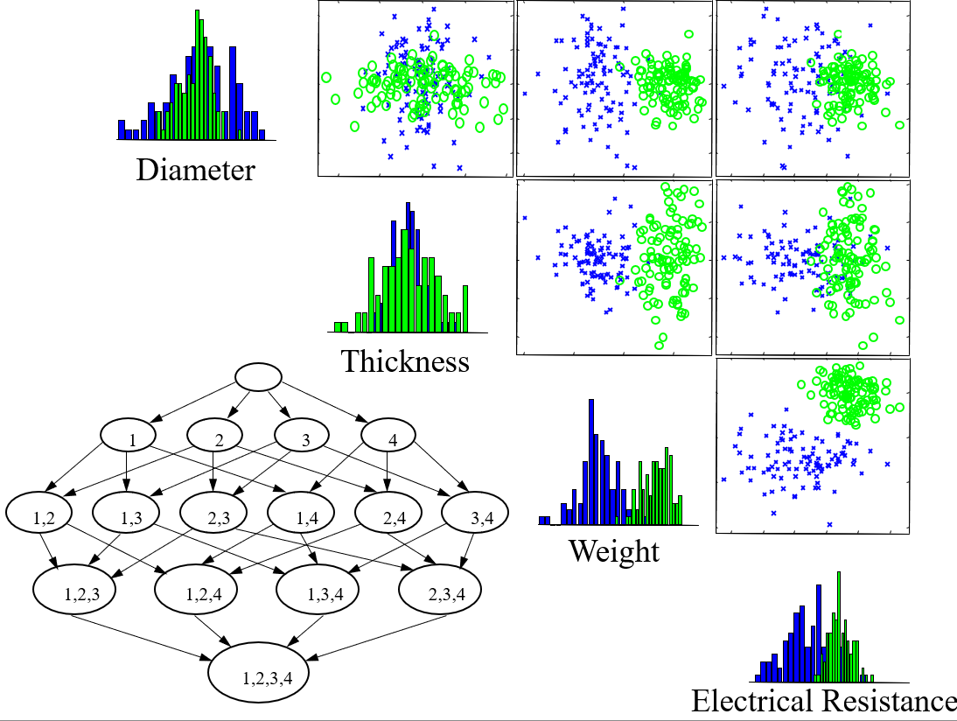

Slide 22
Given a set of N features, there are 2^N – 1 feature subsets we can test
In this case we can test all of them (exhaustive search), but in general this is not possible
10 features = 1,023
20 features = 1,048,576
100 features = 1,267,650,600,228,401,496,703,205,376
We typically resort to greedy search
1
2
3
4
Greedy Forward Section
Initial state: Empty Set: No features
Operators: Add a single feature.
Evaluation Function: K-fold cross validation.
1,2
1,3
2,3
1,4
2,4
3,4
1,2,3
1,2,4
1,3,4
2,3,4
1,2,3,4

Slide 23
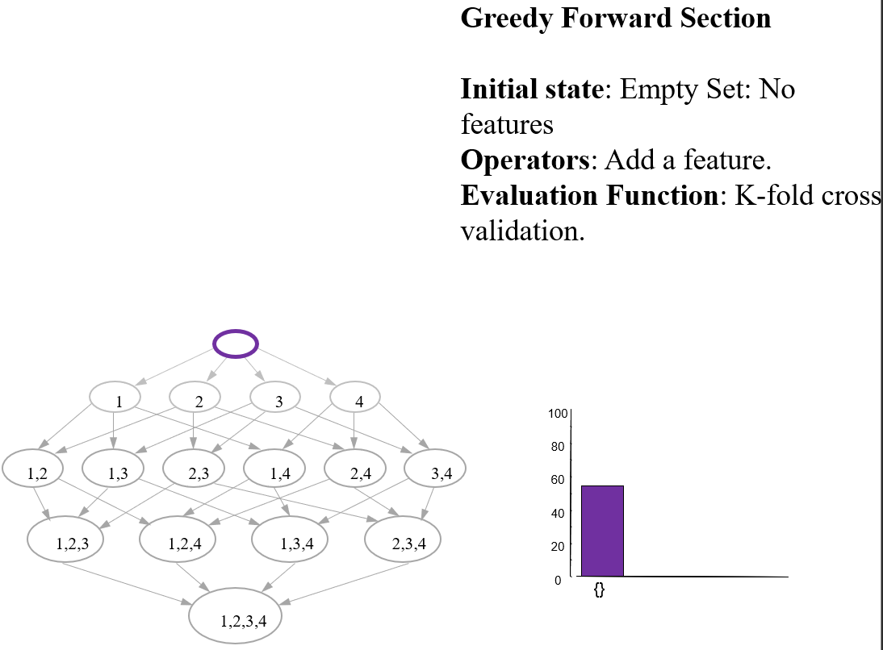

Slide 24
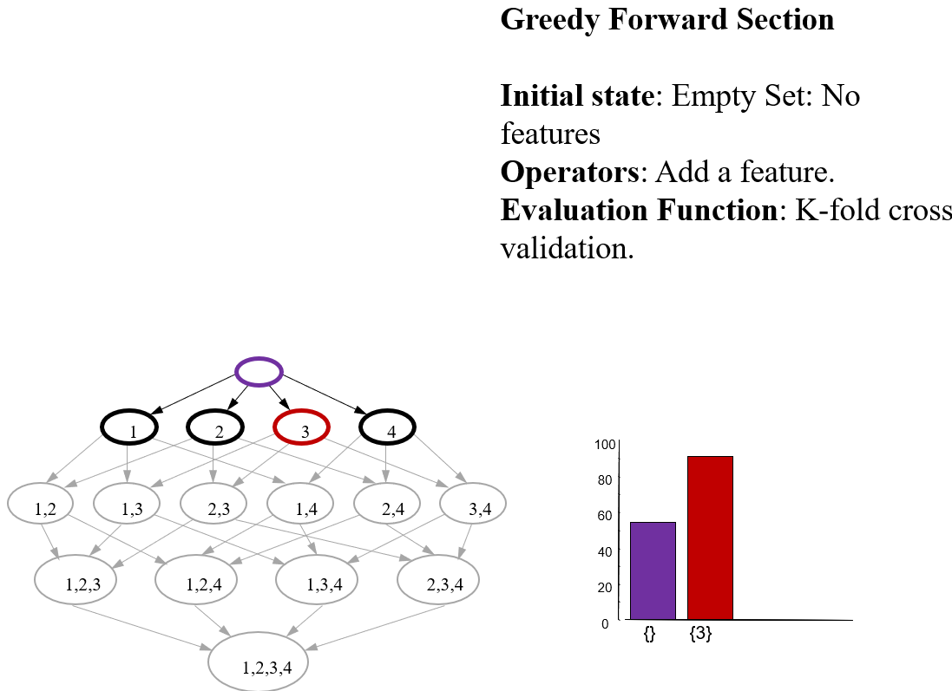

Slide 25
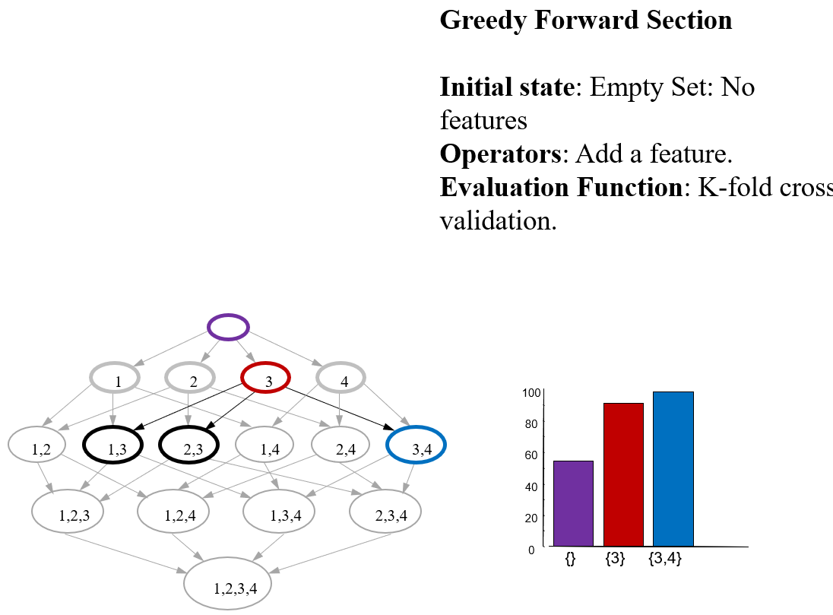

Slide 26
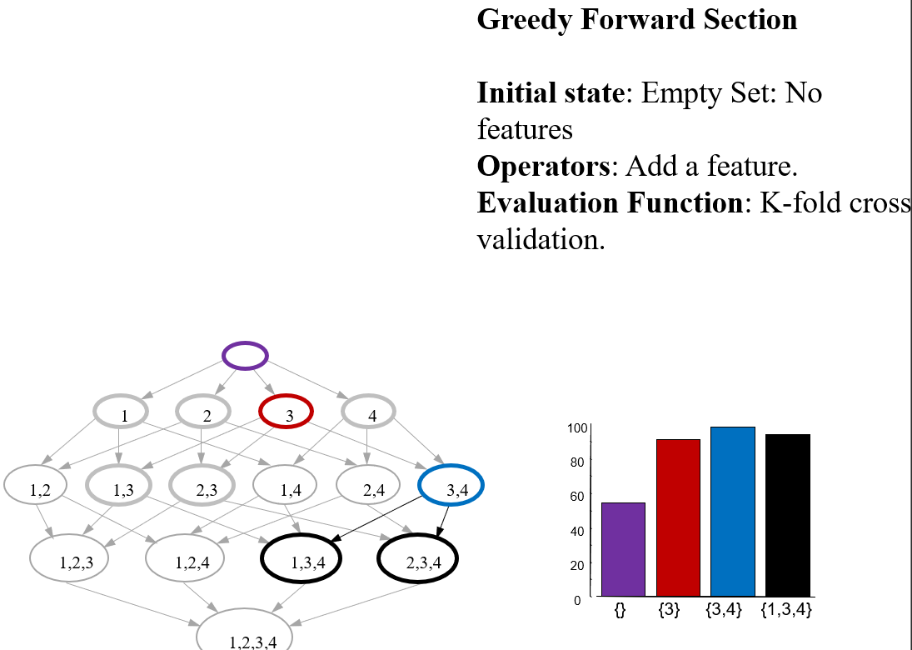

Slide 27
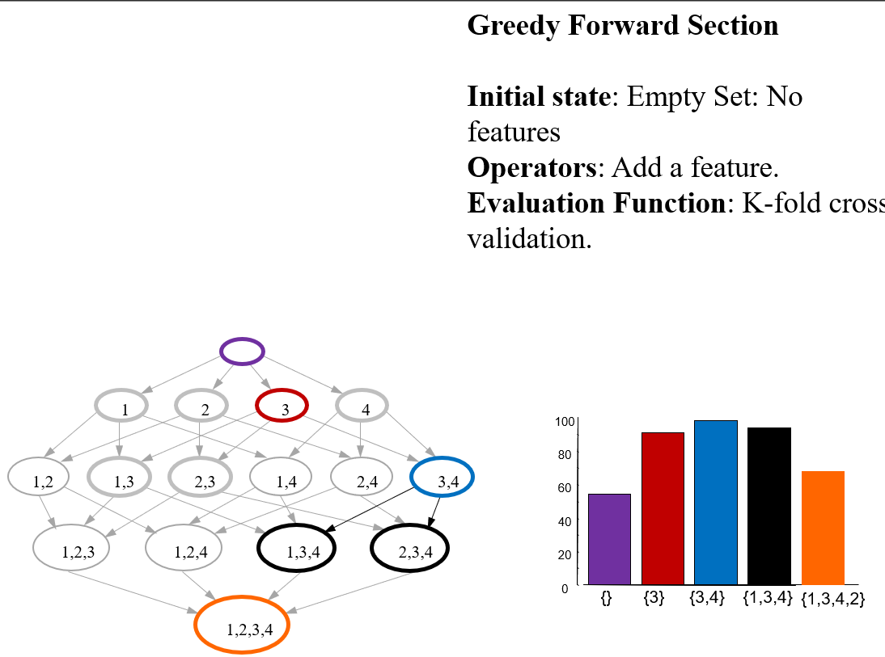

Slide 28
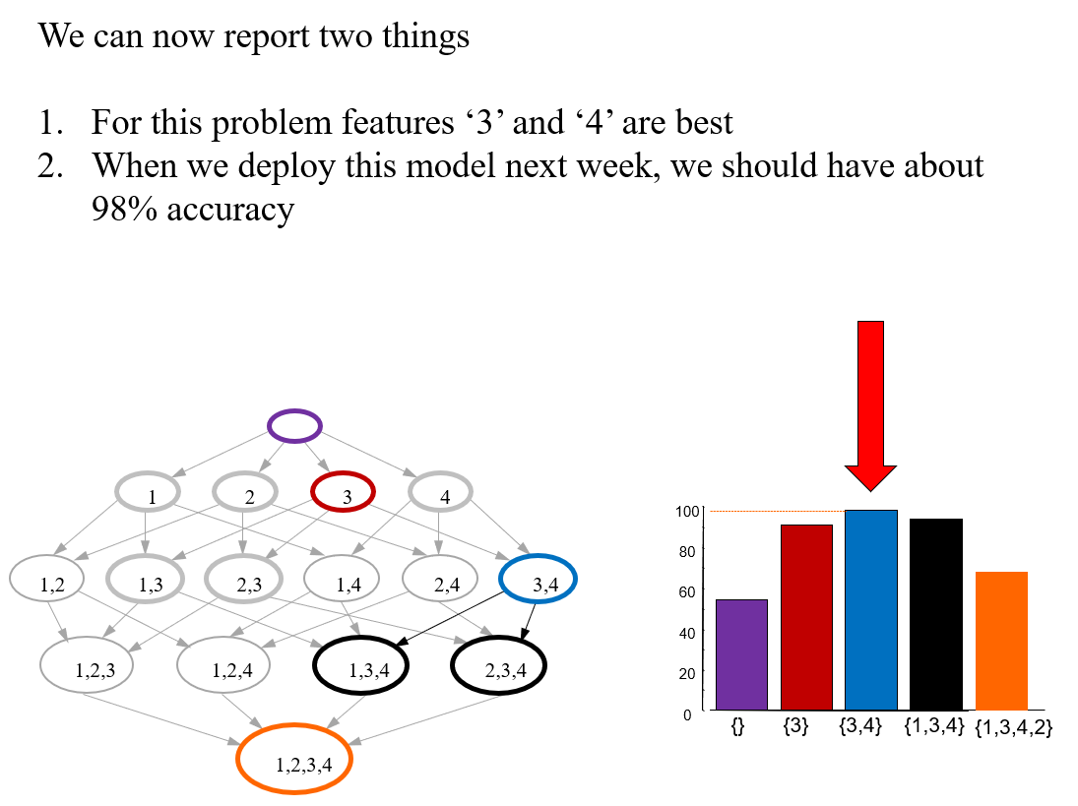

Slide 29
Midpoint Summary
We have seen one way to make classification more accurate
-Search for the best set of features
This takes almost no skill, the computer does the work
There is another way to make classification more accurate
-Transform the features (generate new features)
This can be very powerful, but it does take some human skill. Lets see some examples

Slide 30
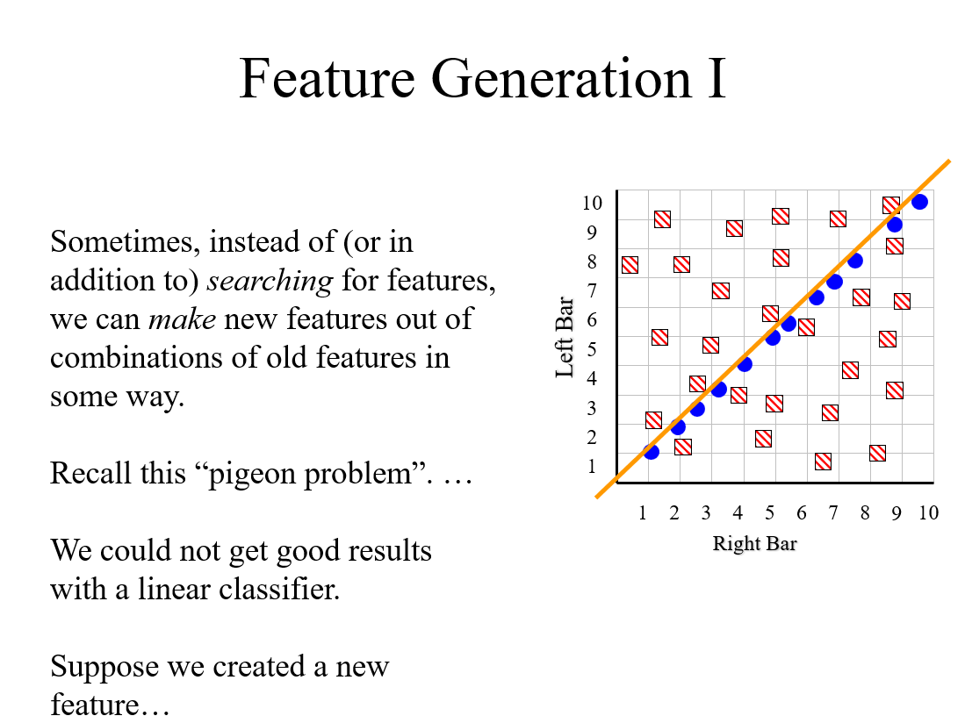

Slide 31
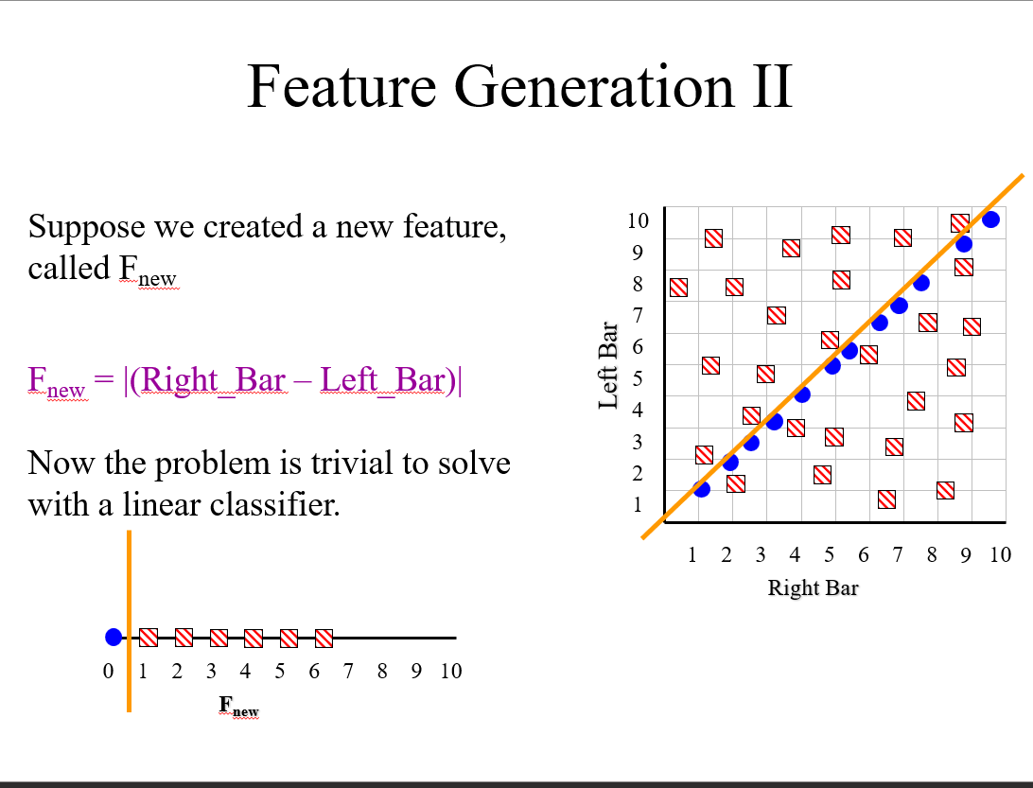

Slide 32
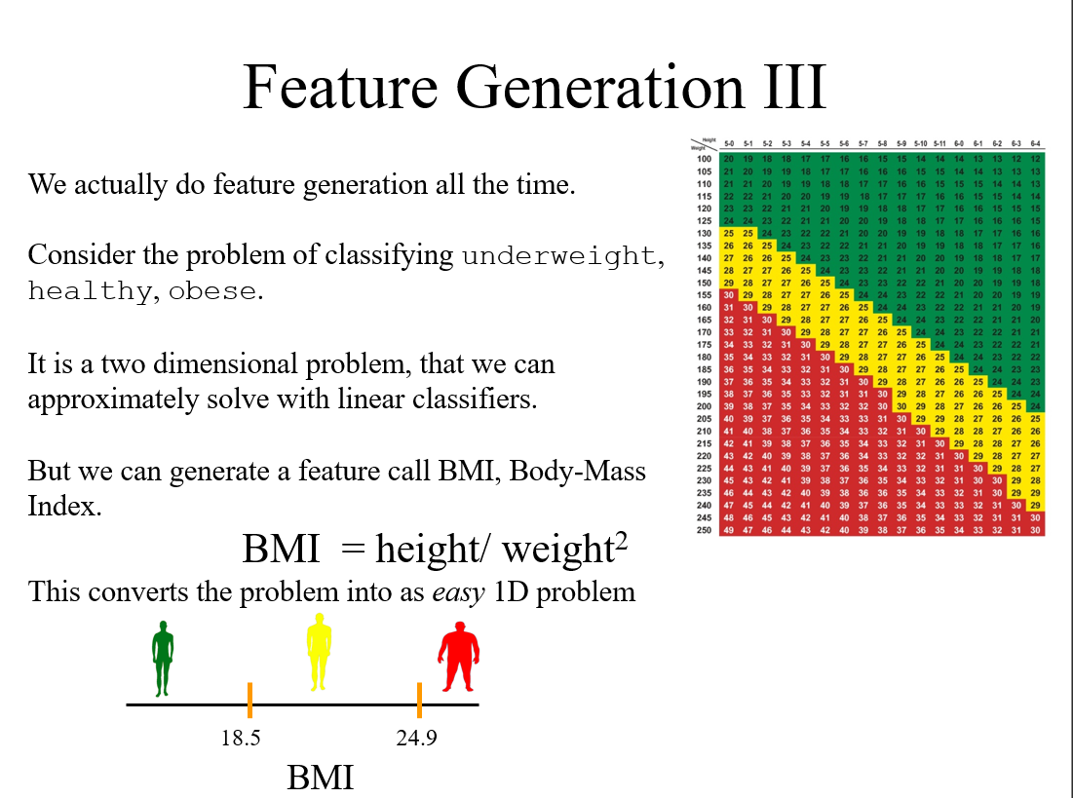

Slide 33
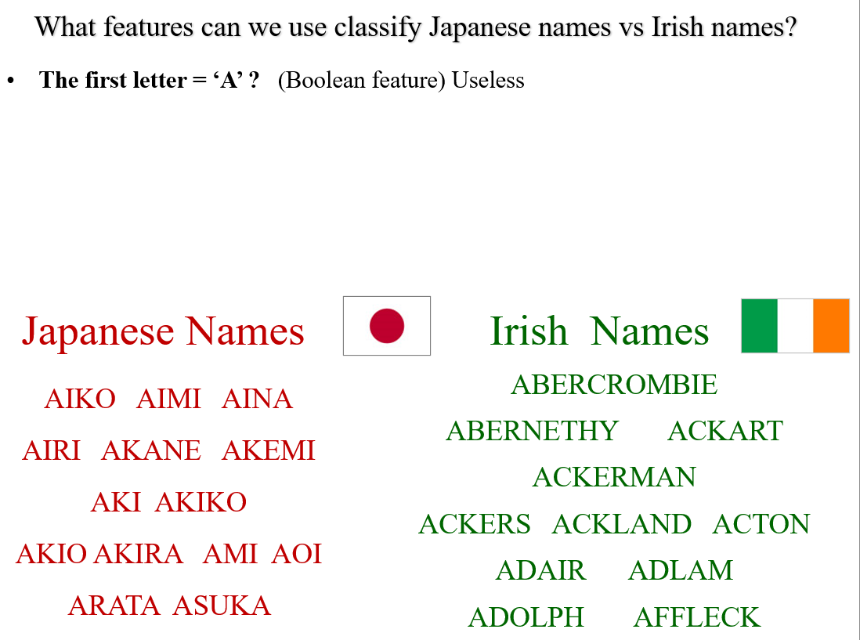

Slide 34
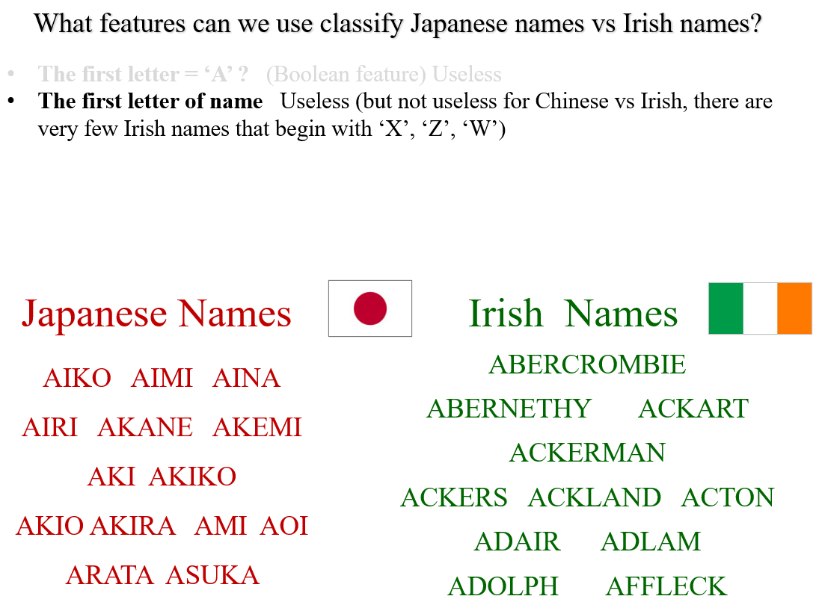

Slide 35
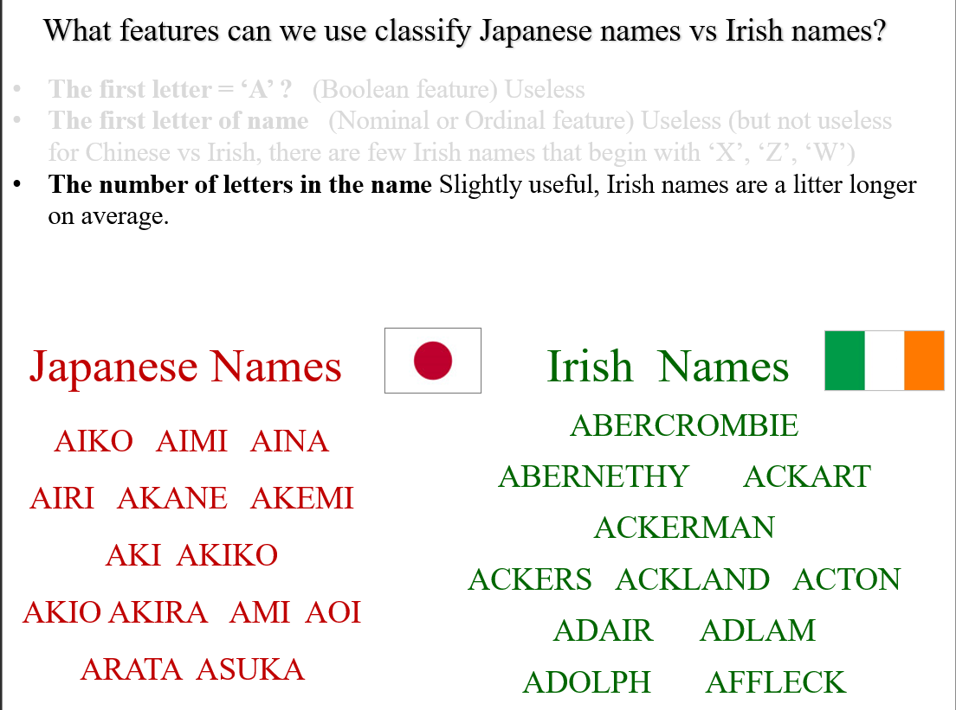

Slide 36
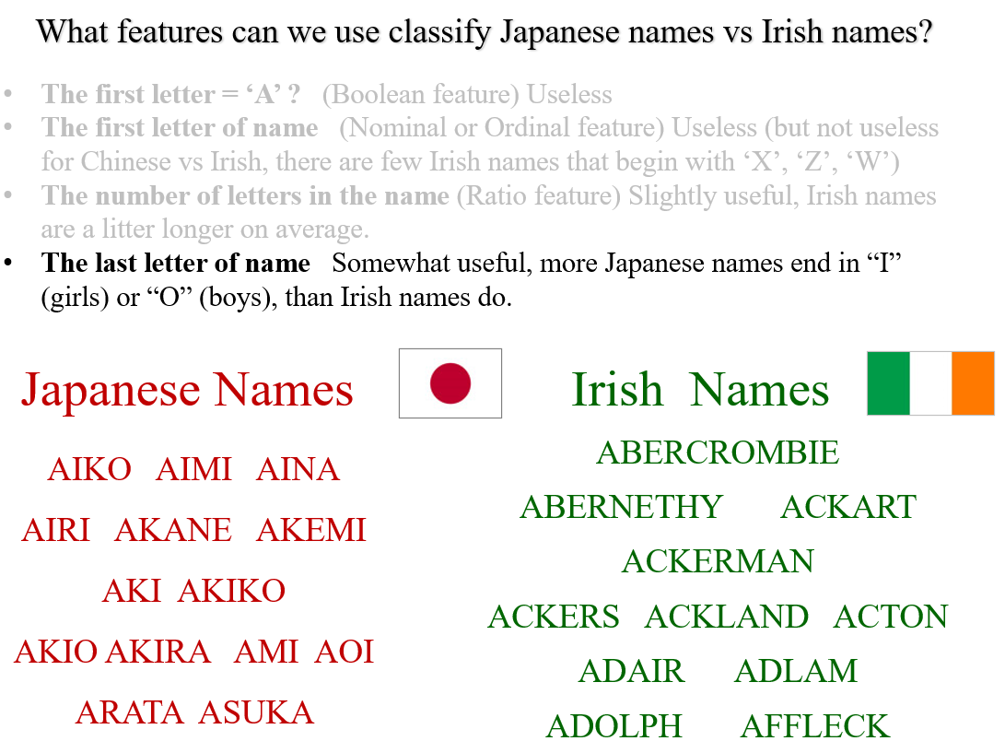

Slide 37
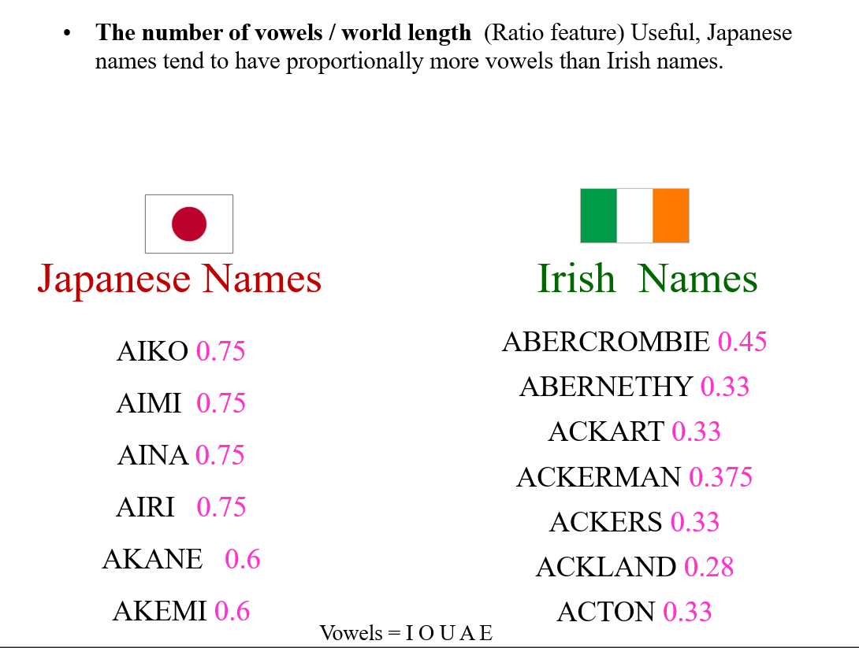

Slide 38
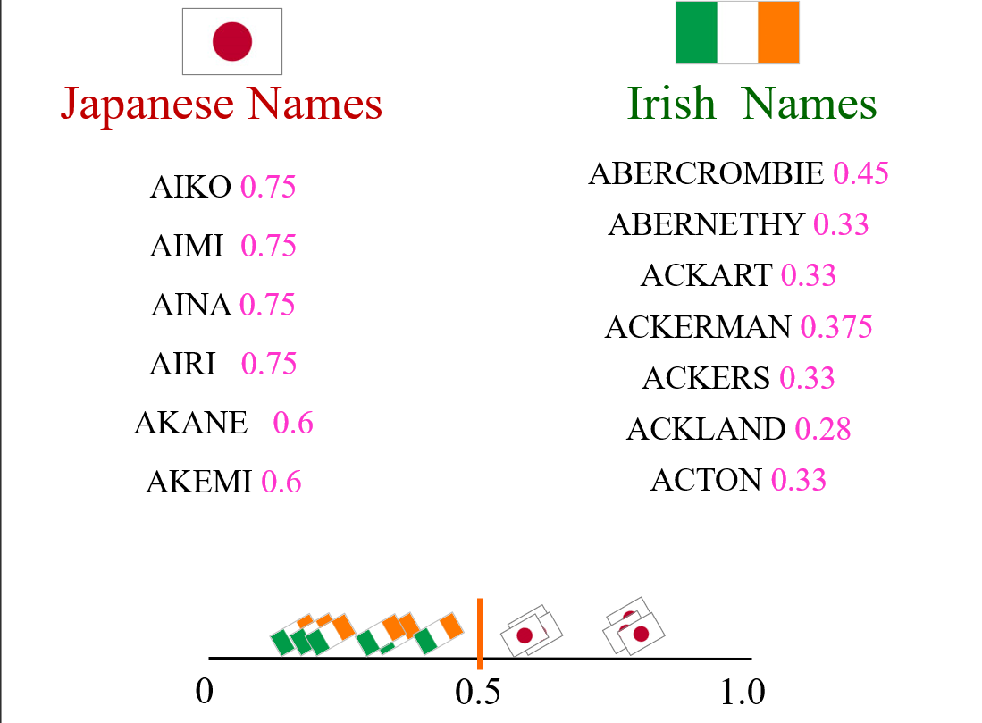

Slide 39
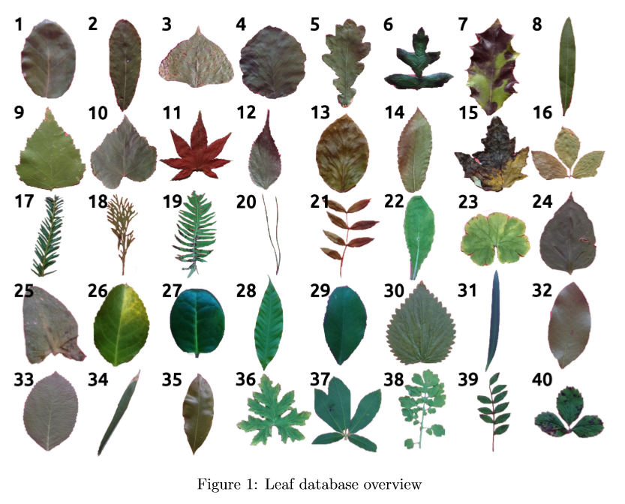
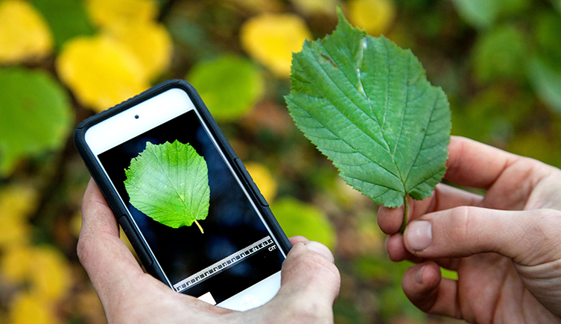
Lets do one more.
Suppose we want to build a classifier for leaf’s (note that such systems exist)
What features should we use?
http://leafsnap.com

Slide 40
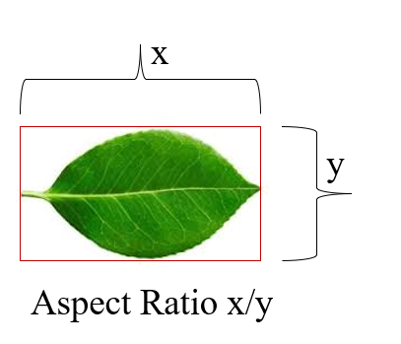

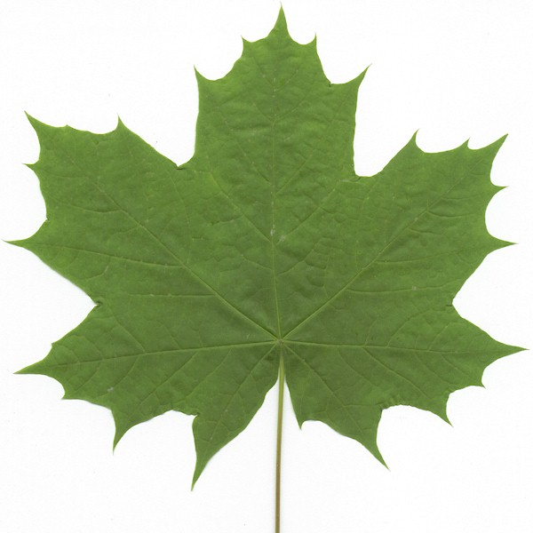
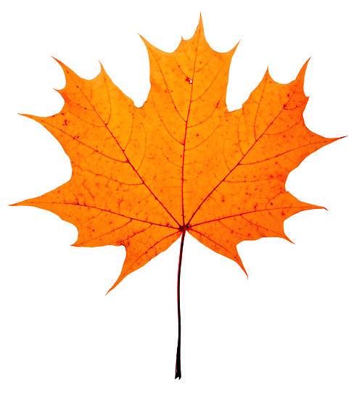
Can we use size as a feature?
Can we use color as a feature?
Can we use aspect ratio as a feature?

Slide 41
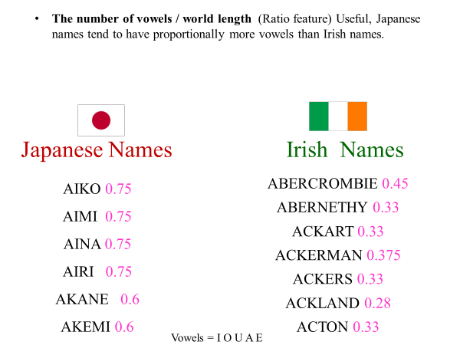
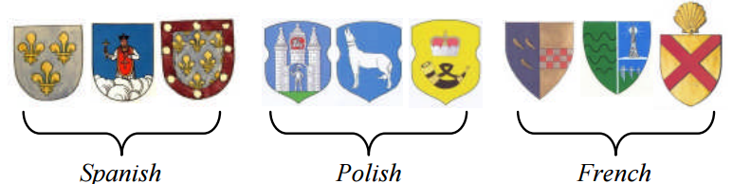
This little example of feature generation is something AI researchers spend a lot of time doing
With the right features, most algorithms will work well. Without the right features, no algorithm will work well.
There is no single trick that always works, but as we “play” with more and more datasets, we get better at future generation over time.
What feature(s) do we use here?

Slide 42
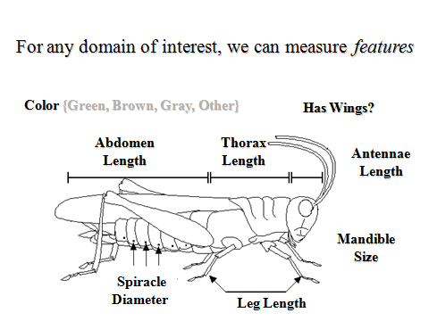
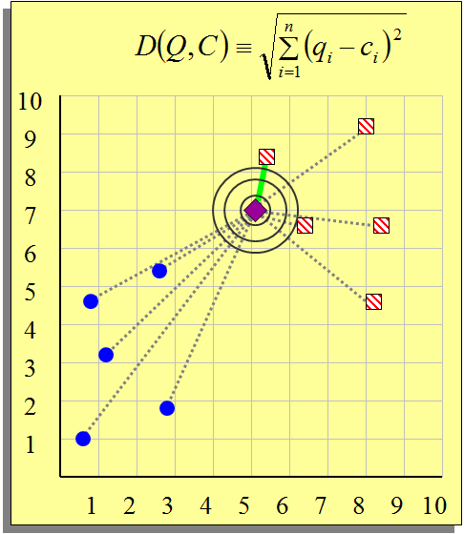
So far we have only seen features that are real numbers
But features could be:
Boolean (Has Wings?)
Categorical (Green, Brown, Gray)
Etc
How do we handle such features?
The good news is that we can always define some measure of “nearest” for nearest neighbor for basically any kinds of features.
Such measures are called distance measures (or sometime, similarity measures)

Slide 43
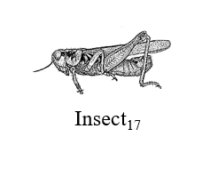
Let us consider an example that uses Boolean features:
Features:
Has wings?
Has spur on front legs?
Has cone-shaped head?
Length(antenna) > 1.5* length(abdomen)
Under this representation, every insect is just Boolean vector:
Insect_17 = {true, true, false, false}
or
Insect_17 = {1, 1, 0. 0}
Instead of using the Euclidean distance, we can use the Hamming distance (or one of many other measures)
Which insect is the nearest neighbor of Insect_17 = {1, 1, 0, 0}?
Insect_1 = {1, 1, 0, 1}, Insect_2 = {0, 0, 0, 0}, Insect_3 = {0, 1, 1, 1}
Here we would say Insect_17 is in the blue class.

Slide 44
Lets talk about some more features

Slide 45
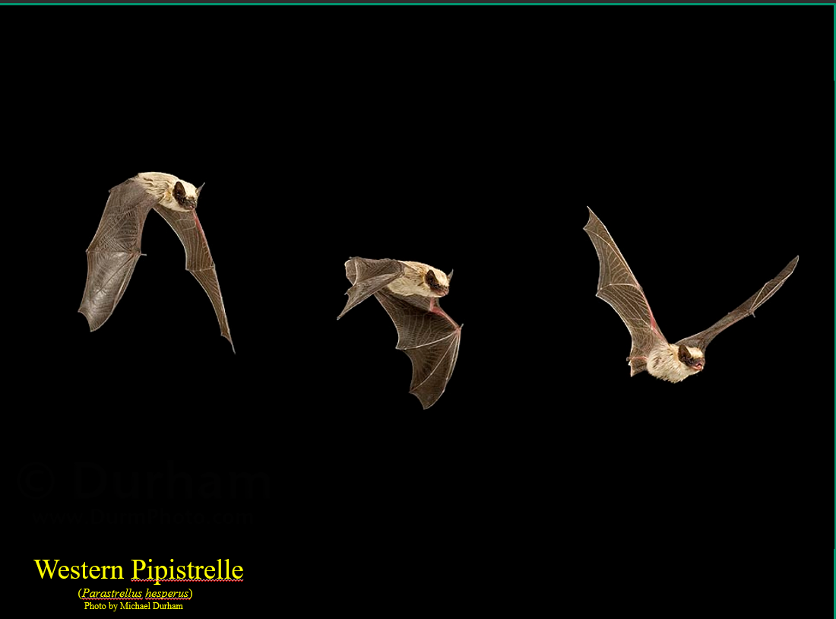

Slide 46
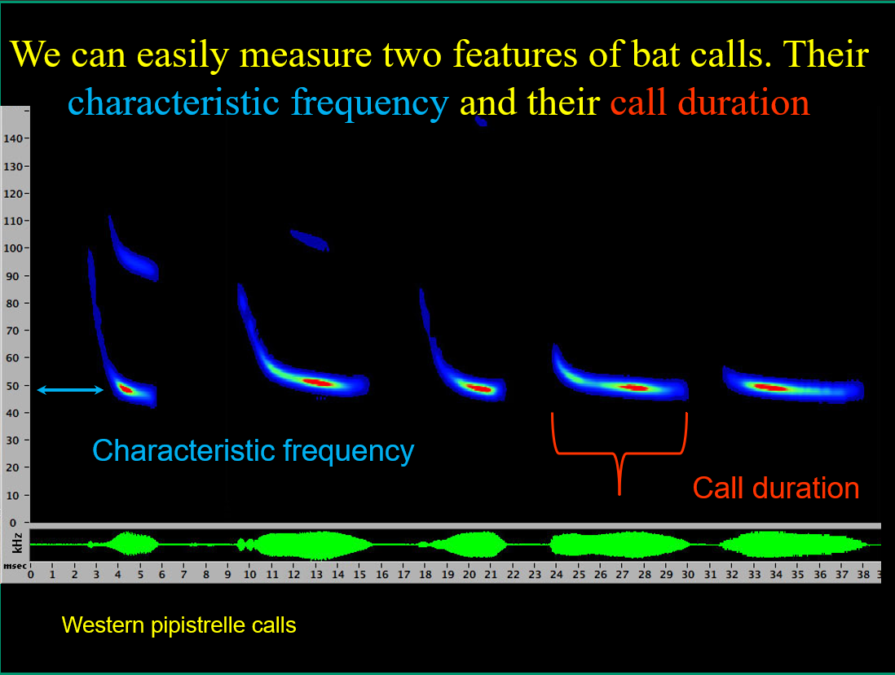

Slide 47
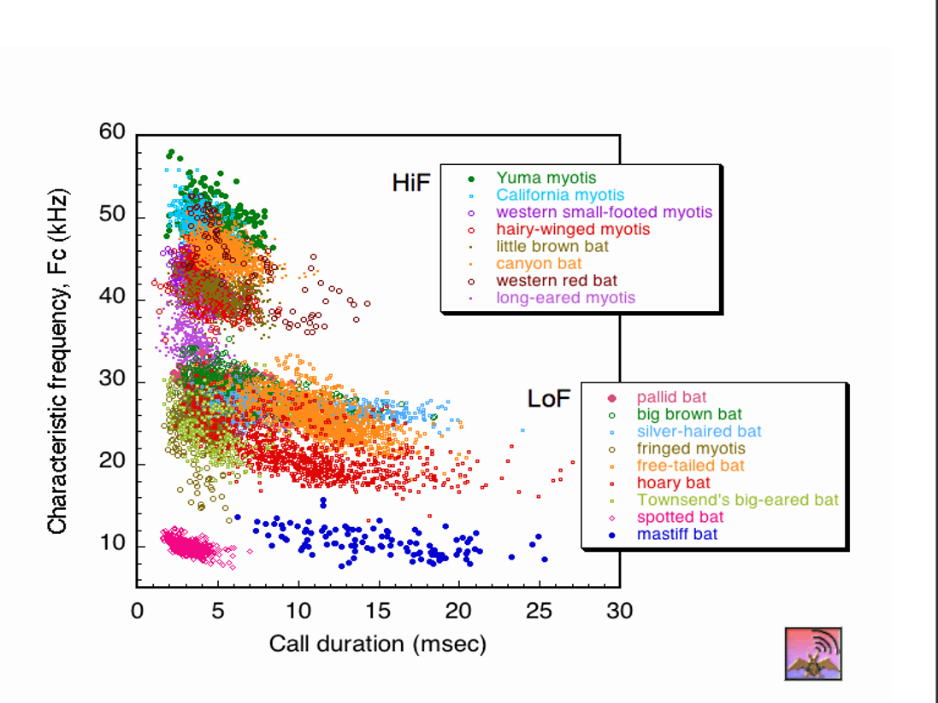

Slide 48


Slide 49


Slide 50


Slide 51


Slide 52


Slide 53


Slide 54


Slide 55


Slide 56
Overfitting
How do we choose the right model?
It is tempting to say: Test all models, using cross validation and pick the best one
However, this has a problem. If we do this, we will find that a more complex model will almost certainty do better on our training set, but will worse when we deploy it. This is overfitting, a major headache in machine learning

Slide 57


Slide 58


Slide 59


Slide 60


Slide 61


Slide 62


Slide 63


Slide 64


Slide 65


Slide 66


